Slide 1

Setup server to provide REST API

Slide 2
Objectives
Setup server to provide REST API
How to integrate Db2 data with the chatbot.
Setup REST API

Slide 3
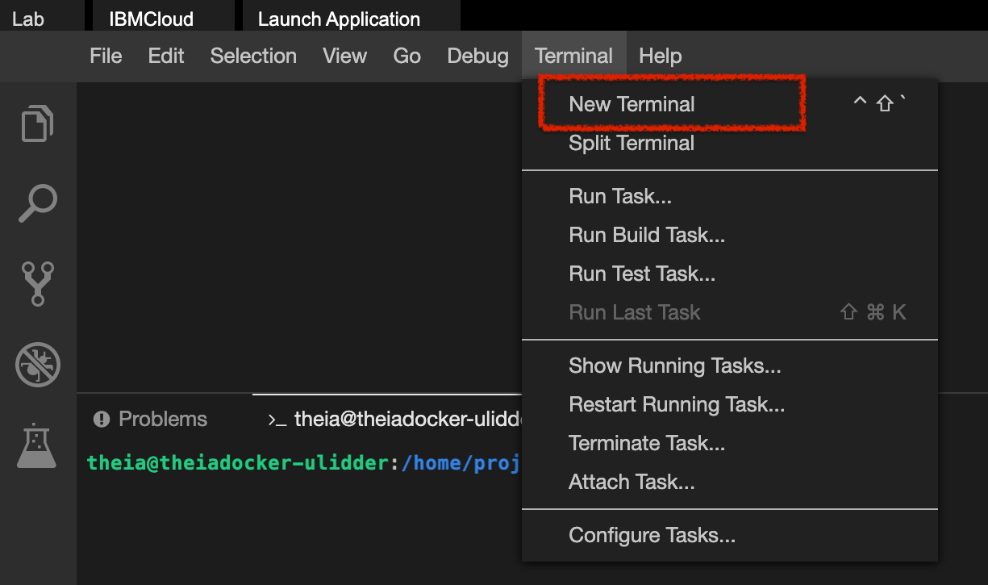
Clone the Github repository
Open a terminal window using the editor's menu: Terminal > New Terminal.
Setup REST API

Slide 4
Clone the Github repository
Go to the project home directory.
  cd /home/project
The code has been done for you already. Run the following command to Git clone the project directory using the below clone command:
  git clone https://github.com/ibm-developer-skills-network/ncehu-AppliedAI_6_Module4.git
Setup REST API

Slide 5
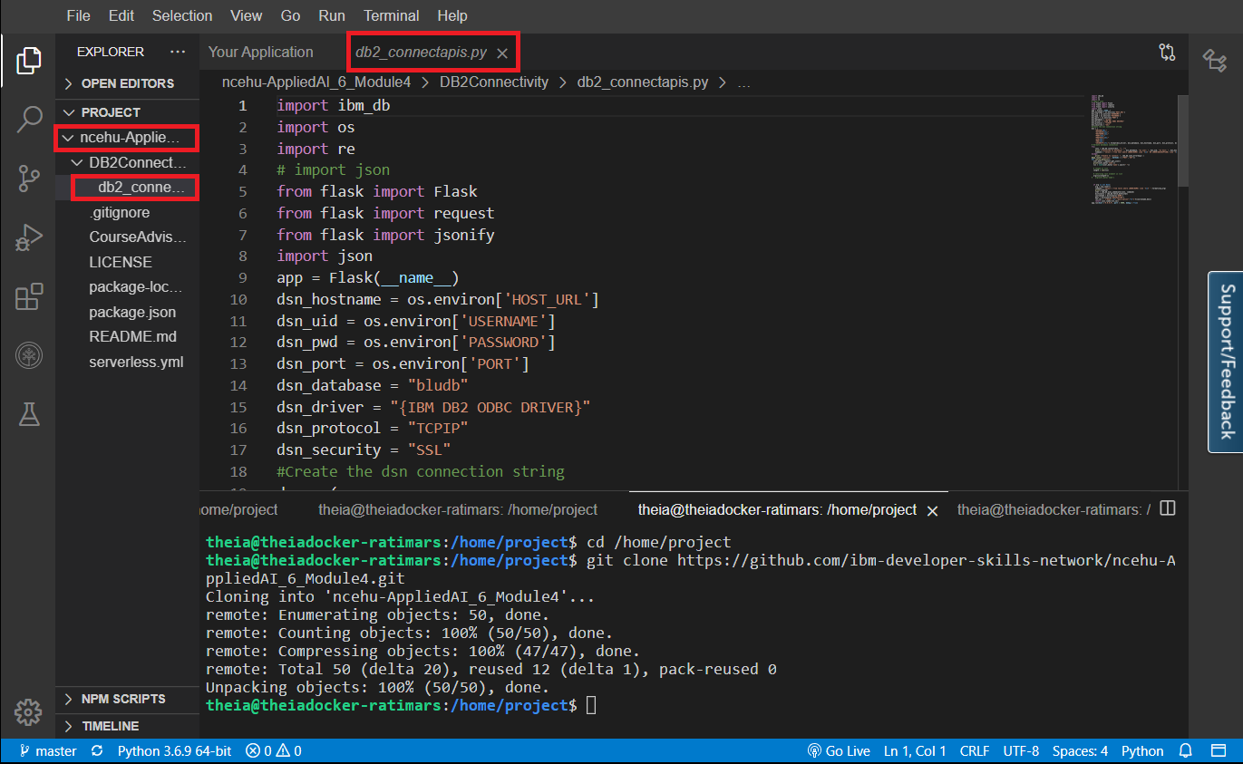
Clone the Github repository
You should see a project ncehu-AppliedAI_6_Module4 listed in the left sidebar of Theia IDE. Click on the ncehu-AppliedAI_6_Module4 folder, navigate to DB2Connectivity then open db2_connectapis.py.
Setup REST API

Slide 6
Clone the Github repository
On the theia terminal, change to project directory
  cd ncehu-AppliedAI_6_Module4/DB2Connectivity
Setup REST API

Slide 7
Connecting Watson Assistant Chatbot to Db2 database
On your theia terminal, you need to export all four variables by replacing their values. Run the following commands one by one to set username, password, host_url, and port, as shown in the image below:
  export USERNAME=<userid>
  export PASSWORD=<password>
  export HOST_URL=<host_url>
  export PORT=<port>
Setup REST API

Slide 8
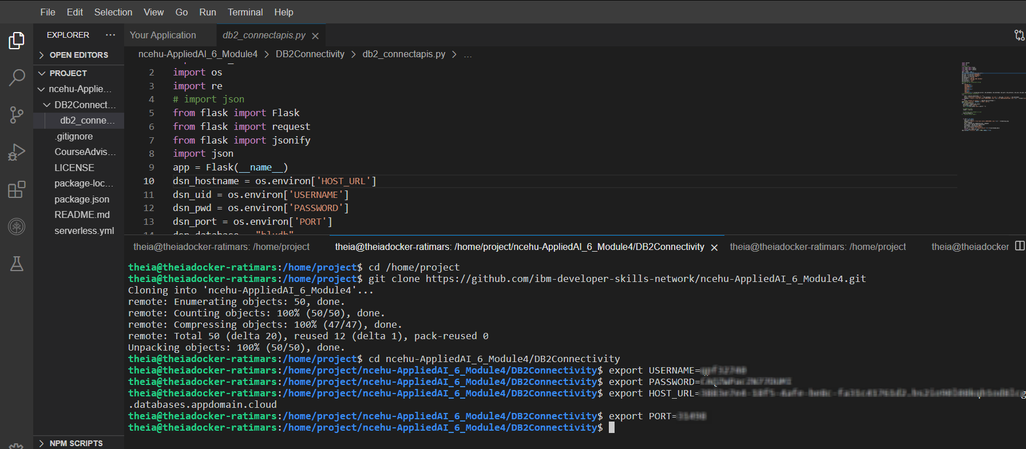
Connecting Watson Assistant Chatbot to Db2 database
Setup REST API

Slide 9
Connecting Watson Assistant Chatbot to Db2 database
Run the following command to install packages:
  python3 -m pip install ibm_db
  python3 -m pip install flask
Run the following command to start the server:
  python3 db2_connectapis.py
Setup REST API

Slide 10
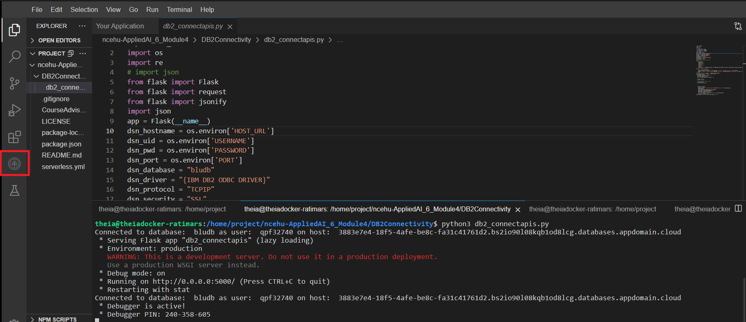
Connecting Watson Assistant Chatbot to Db2 database
Click on the Skills Network button on the left, it will open the Skills Network Toolbox.
Setup REST API

Slide 11
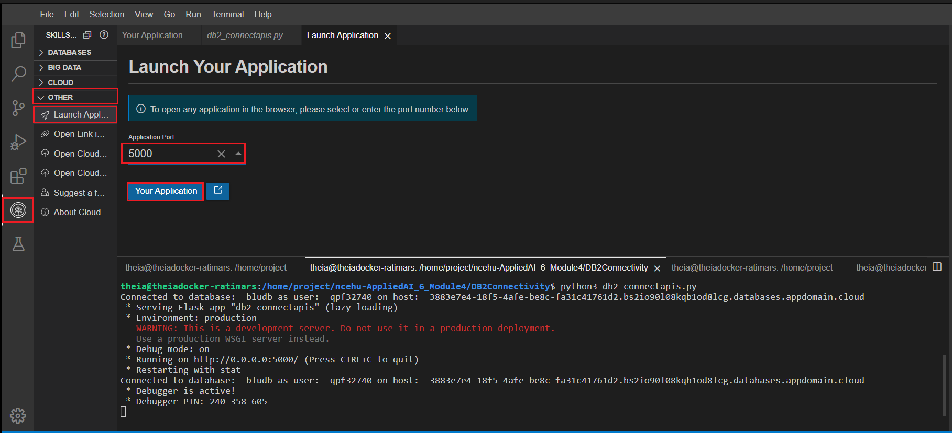
Connecting Watson Assistant Chatbot to Db2 database
Then click the Other then Launch Application. From there you should be able to enter the port. Connect to port 5000and click Launch button.
Setup REST API

Slide 12
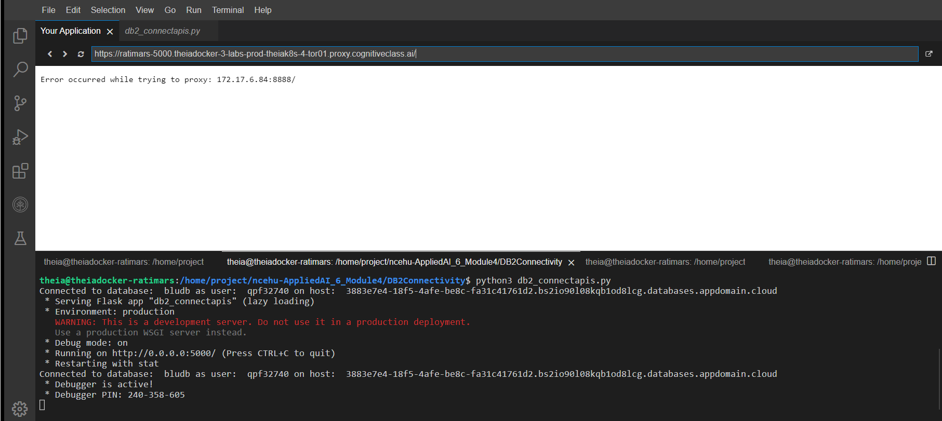
Connecting Watson Assistant Chatbot to Db2 database
You should see this page open up.
Setup REST API

Slide 13
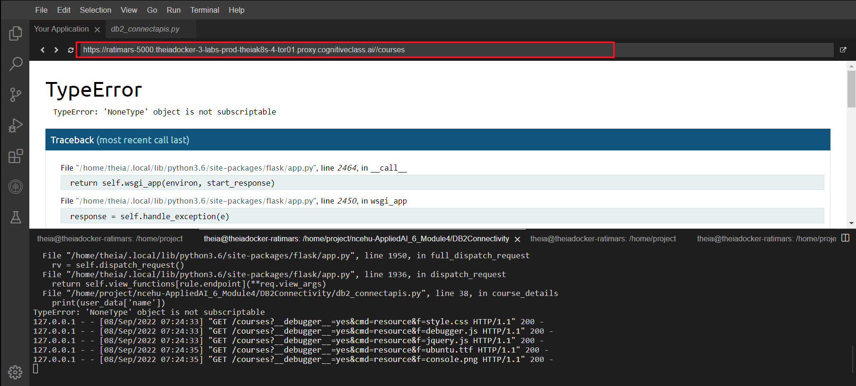
Connecting Watson Assistant Chatbot to Db2 database
At the end of the URL, you need to add /courses and hit enter, so the URL should look like and the page should show up:
Setup REST API

Slide 14
Summary
Setup server to provide REST API
How to integrate Db2 data with the chatbot.
Setup REST API

Slide 15
Q & A
Setup REST API

